Slide 1

Python camp
Level-1 Lecture-1
Hashira Club (Reboot Club) Made by : Haidy Salem

Slide 2
Lecture flow
01. introduction about Hashira
❄ ❄
❄ ❄ ❄ ❄ ❄ ❄ ❄ ❄ ❄ ❄ ❄ ❄ ❄ ❄
02. Camp team monitors & assistant
03. Answer the form questions
04. Level-1 Road Map 05. permitive data types+ input output
+Indentation+Comments

Slide 3


01.introduction about Hashira .
FCI Hashira Club : we are students in Faculty of Computers and Artificial Intelligence (FCAI) . احنا طلبه من حاسبات و ذكاء اصطناعى جامعه حلوان . اتجمعنا من مراحل مختلفه و هدفنا نتعمق علميا و نربط بين المحتوى العلمى و العملى . FCI Hashira Club youtube channel : https://www.youtube.com/@FCIHashira FCI Hashira Club Linked in : https://www.linkedin.com/company/fcihashira

Slide 4
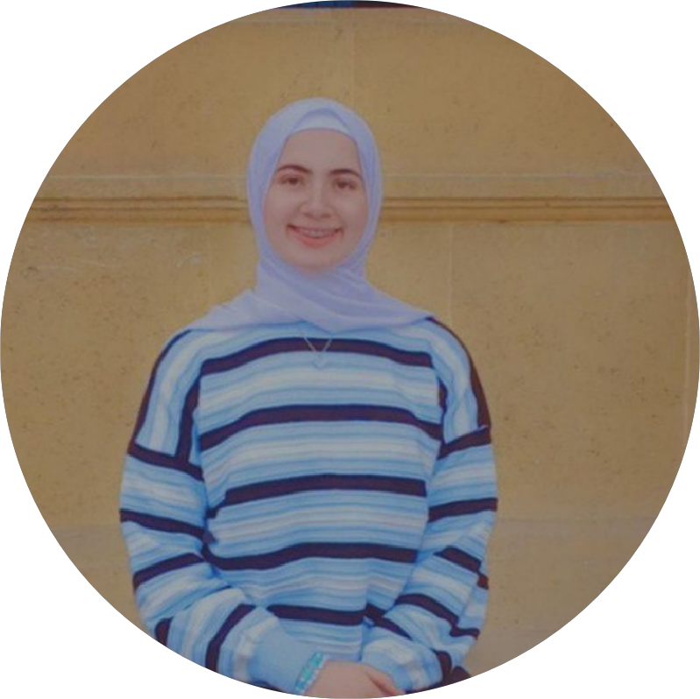
02.Camp team Mentors & assistants
Haidy Salem : Head & Mentor .
started in "Machine Learning and AI with python" ,an online course learning iterative of "Harvard University"
Introduction to Computer Science and Programming Using Python" MIT course.
student in Faculty of Computers and Artificial
Intelligence (FCAI) level 2 .
linked in account :
www.linkedin.com/in/haidy-salem-6b573931b
Youtube channel :
https://youtube.com/@haidysalem2409

Slide 5
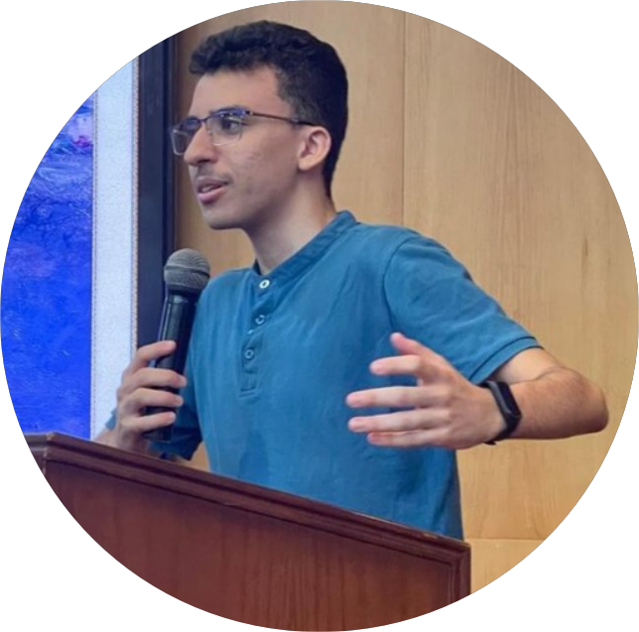
02.Camp team monitors & assistants
Hamza ELkotb Founder, Head & Mentor. student in Faculty of Computers and Artificial
Intelligence (FCAI) level 2 .
linked in account : https://www.linkedin.com/in/hamzaelkotp
Youtube channel :
https://www.youtube.com/@CSCoreDecoded
Github account :
https://github.com/hamzaelkotp

Slide 6
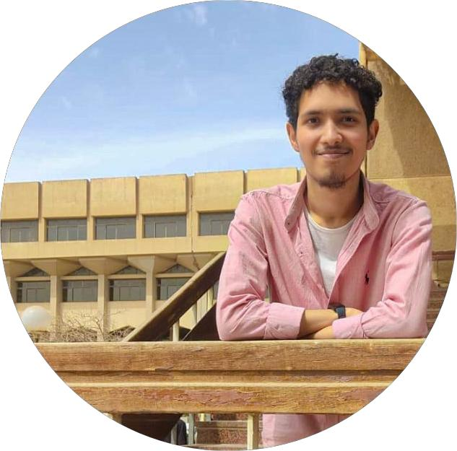
02.Camp team monitors & assistants
Mohamed Ashraf : Assistant. student in Faculty of Computers and Artificial
Intelligence (FCAI) level 2 .
linked in account : https://www.linkedin.com/in/mohamed-ashraf-6610a5348

Slide 7
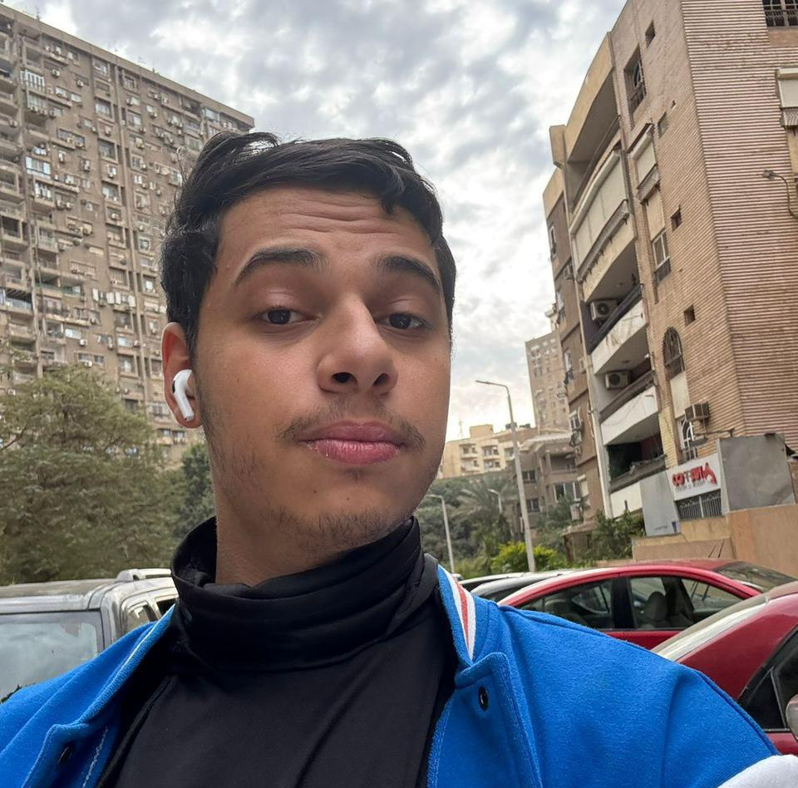
02.Camp team monitors & assistants
Ibrahim (XZ): Mentor. student in Faculty of Computers and Artificial
Intelligence (FCAI) level 3 .
linked in account : https://www.linkedin.com/in/ibrahim-amr-b238bb316
دبلومه هندسه البرمجيات بواسطه بايثون

Slide 8
03. Answer the form questions
Is it useful for be strong in python ? Answer : Why Python is the Best Language for Beginners Top 5 Reasons Why Python is the Best Programming Language
Why Python is Dominating Data Science
The Power of Python in Web Development
كام محاضره فى الاسبوع ؟ فى Is it useful for be strong in python ? المحاضرات هتتسجل ؟ محتاج ابقى دارس ايه قبا اما ابدأ الكامب ؟
مين اللى هيشرح؟ الدراسه ازاى هوفق لما الدراسه تبد أ ؟
؟

Slide 9

Is it useful for be strong in python ? Why I should learn python ?
1.Ease of Learning Python 2.Wide Range of Applications: -Web Development -Data Science and Machine Learning -Automation
-Software Development -Cybersecurity: Many security tools are built in Python
3.Extensive Libraries and Frameworks 4.Job Opportunities

Slide 10
04. Level-1 Road Map (week-1)
Lecter-1
Lecter-2
Lecter-3
Topics
permitive data types
+ input & output
+Indentation
+Comments
Operators
+Conditions
+comparisons
Math Module +Complex math
+loops
+Variable scope
date & time
20/1
mon
7:00pm
22/1
wed
7:00pm
25/1
sat
7:00pm

Slide 11
THANK YOU

